Slide 1
Enhancement Care Management Quality Improvement Program (ECM QIP)
ECM QIP Kick-Off Webinar
Robert Moore, MD MPH MPA, Chief Medical Officer Deanna Watson, QIP Program Manager
Wednesday, October 12, 2022

Slide 2





Agenda
1
About Us
2
Guiding Principles
3
4
ECM Benefit Overview
ECM Quality Improvement Program
5
Contact Us
6
Q & A
2

Slide 3

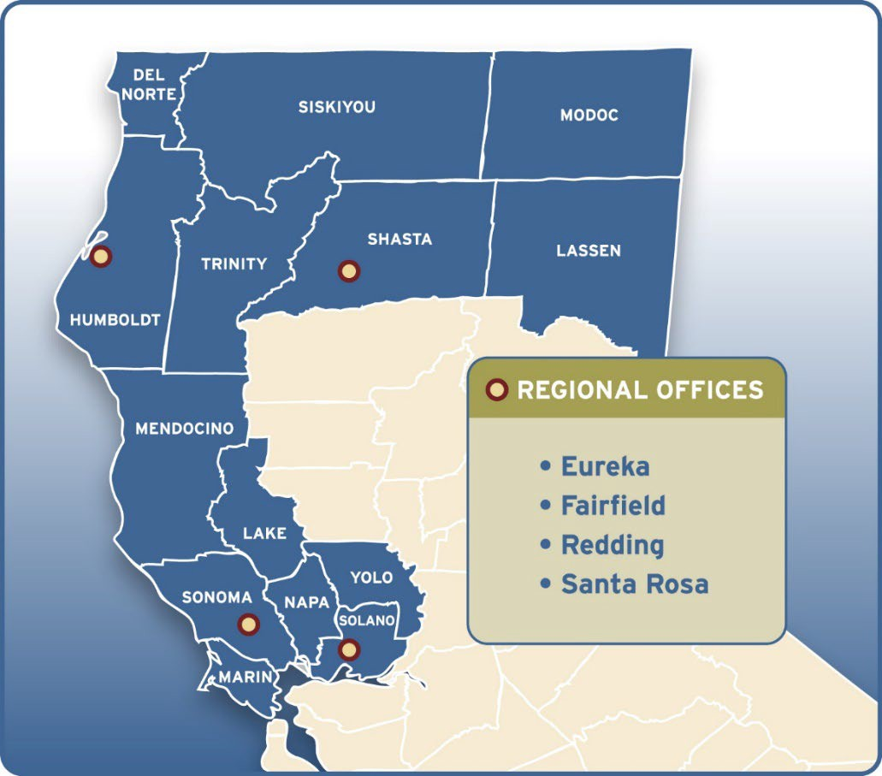

About Us
1
About Us
Mission:
To help our members, and the communities we serve, be healthy.
Vision:
To be the most highly regarded managed care plan in California.

Slide 4
Guiding Principles
2
The ECM QIP adheres to the (3) guiding principles of the DHCS CalAIM program:
Identify and manage member risk and need through whole person care approaches and addressing Social Determinants of Health.
Move Medi-Cal to a more consistent and seamless system by reducing complexity and increasing flexibility.
Improve quality outcomes, reduce health disparities, and drive delivery system transformation and innovation through value- based initiatives, modernization of systems and payment reform.

Slide 5

3 ECM Benefit Overview

Slide 6
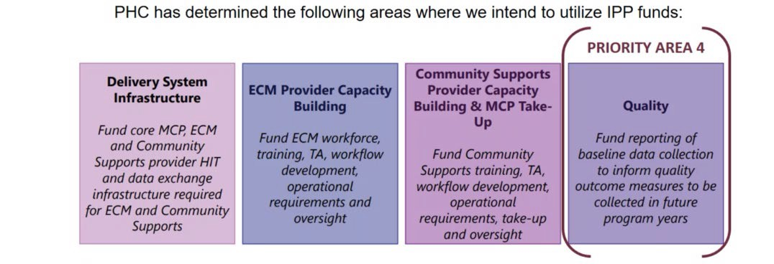
ECM Benefit Overview
Enhanced Care Management (ECM)
A benefit that is part of the California Advancing and Innovating Medi-Cal (CalAIM) initiative. CalAIM is a multi-year initiative, organized by the DHCS to address the complex challenges facing California’s most vulnerable residents.
A Medi-Cal benefit that replaced the Whole Person Care (WPC) pilot and Intensive Outpatient Care Management (IOPCM) activities.
ECM QIP

Slide 7

ECM Benefit Overview
Populations of Focus
7 identifier groups of individuals are eligible for the ECM benefit, and benefits for 3 of these groups were launched in 2022:
Adult individuals experiencing homelessness, as defined by HUD
Adult High Utilizer individuals with five (5) or more emergency room visits in a six-month period
Adult individuals with SMH or SUD
For detailed information for each identifier group and eligibility criteria, please review on the DHCS website.
2022 Go-Live Schedule
Phase I: January 1, 2022 | Phase II: July 1, 2022 | Phase III: January 1, 2023 | Phase IV: July 1, 2023
Marin Napa Mendocino Shasta Sonoma | Solano Trinity Lake Siskiyou Yolo Modoc Humboldt Lassen Del Norte | All 14 Counties | All 14 Counties

Slide 8
ECM QIP
4
Enhanced Care Management Quality Improvement Program

Slide 9
ECM QIP Defined
PHC’s Enhanced Care Management Quality Improvement Program (ECM QIP) is an extension of CalAIM ECM initiatives.
Using IPP funds, participating ECM QIP providers are incentivized for reporting measures.
ECM is shifting from strictly pay-for-reporting to an expanded incentive program that incentivizes performance and quality improvement.
PHC has expertise in pay-for-reporting and pay-for- performance programs through other QIP’s for primary care, hospitals, perinatal, long-term, and palliative care.

Slide 10
ECM QIP Timeline
2022 Measurement Year
January 1 – December 31
2023
Jan | Feb | Mar | Apr | May |  | Jun |  | Jul | Aug |  | Sep |  | Oct | Nov |  | Dec
 |  |  |  | Q1 2023 QIP Payment (May 31) |  |  |  |  | Q2 2023 QIP Payment (Aug 31) |  |  |  |  | Q3 2023 QIP Payment (Nov 30)
Jan
Feb
Q4 2022 QIP
Payment (Feb 28)

Slide 11
Gateway Measure: Timely Reporting
Reporting Timeline & Templates
ECM Provider Return Transmission File (RTF) Naming Convention: Facility Name_RTF_Date | DUE MONTHLY 2nd week of the month* | Link: Provider Return Transmission File (RTF) PHC sends pre-populated RTF to Provider (1st week of the month) Provider submits RTF via sFTP folders
ECM Provider Initial Outreach Tracker File (IOT) Naming Convention: Facility Name_IOT_Date | DUE MONTHLY 2nd week of the month* | Link: Provider Initial Outreach Tracker File (IOT) Provider submits IOT via sFTP folders
Provider Capacity Survey | DUE MONTHLY 4th week of the month (no later than Tuesday)* | PHC sends survey via Google Docs to Provider (3rd^{rd} week of the month).** Provider submits survey via Google Docs
*Dates subject to change. See specifications for more information.
**The Provider Capacity Survey is available to providers via Google Docs or another form of communication agreed upon by PHC and ECM provider.

Slide 12
Payment Methodology
How does it work?
Providers are evaluated based on the gateway measure and its incentive pool amount. This measure determines incentive dollars available for other reporting measures in program, with opportunity to earn a percentage of the allotted incentive pool based on full or partial credit, with potential to earn 100% of the allocated incentive dollars available in the pool.
The incentive rate is $100 per member per month (PMPM). This means for every enrolled ECM member, $100 will be placed in an incentive pool based on the following submission deadlines for all 3 reporting requirements:
On or before due date – accrue 100% of incentive dollars
1 week or 5 business days past due date – accrue 50%
Submissions not received within 5 business days are considered late and not eligible for incentive dollars.
Reports over 30 days late initiatives a corrective action which can include separation from participation in the ECM program.

Slide 13
Payment Methodology
How is the incentive payment calculated?
Providers can earn a percentage of the allotted incentive pool money if they meet one or more of three reporting measures:
Measure 1: up to 30% of total incentive pool
Measure 2: up to 35% of total incentive pool
Measure 3: up to 35% of total inventive pool
Example:
Provider has 10 patients and submits timely reports for 3 months in a quarter:
10 patients x $100 (PMPM) x 3 months = $3,000 placed in incentive pool
If provider earns full credit for Measures 2 and 3, but no credit for Measure 1, they would earn 70% of the incentive pool:
Measure 2 (35%) + Measure 3 (35%) = 70% of $3,000 in incentive pool
= $2,100 incentive payment for the quarter

Slide 14

Measure 1
Care Plan Submission into Collective Medical
Description: Providers need to enter a Care Plan and Shared Consent form into Collective Medical within 30 days of enrollment. Care Plans and Shared Consent forms must be entered between October 1 - December 31, 2022.
Thresholds: Eligible Incentive: 30% of total incentive pool Targets: Full credit: > 80%
Partial credit: 70 - 79%
Denominator: The number of ECM enrolled members within 30 days of enrollment into Collective Medical
Numerator: The number of ECM enrolled members with Care Consent forms successfully entered in Collective Medical
Reporting Guidelines: Provider must enter both documents Medical within 30 days of enrollment. No submission to PHC will audit Collective Medical for evidence of documents.
Plans and Shared
into Collective
is required. PHC

Slide 15
Measure 2
PHQ-9 Depression Screening
Description: Depression screening using the Patient Health Questionnaire-9 (PHQ-9) needs to be completed for all ECM enrolled members as part of initial assessment and development of the Care Plan. All PHQ-9 depression screening reported must be between January 1 - December 31, 2022.
Thresholds: Eligible Incentive: 35% of total incentive pool Targets: Full credit: > 90%
Partial credit: 80 - 89%
Denominator: The number of ECM enrolled members within the eligible ECM populations of focus
Numerator: The number of ECM enrolled members within the eligible ECM populations of focus who were appropriately screened for depression
Reporting Guidelines: Provider will submit the member’s name, PHQ-9 screening date, score of the most recent screening, and other pertinent information using
the PHQ-9 Depression Screening & Blood Pressure Screening Template. This file must be submitted quarterly via sFTP folders.

Slide 16
Measure 3
Controlling Blood Pressure (CBP) - Blood Pressure Monitoring
Description: Blood pressure (BP) screening needs to be completed for ECM enrolled members regardless of prior diagnosis of hypertension. Screening must be by in-person visit by ECM staff, clinic visit, or patient use of PHC approved home BP kit. Screening results must be documented in case management record for potential audit. All blood pressures reported must be between January 1 - December 31, 2022.
Thresholds: Eligible Incentive: 35% of total incentive pool Targets: Full credit: > 80%
Partial credit: 70 - 79%
Denominator: The number of ECM enrolled members within the eligible ECM populations of focus
Numerator: The percentage of ECM enrolled members within the eligible ECM population of focus who were appropriately screened for blood pressure.
Reporting Guidelines: ECM providers must submit the member’s name, BP pressure screening date, score of the most recent screening, and other pertinent information using the PHQ-9 Depression Screening & Blood Pressure Screening Template.
This file must be submitted quarterly via sFTP folders.

Slide 17
PHQ-9 Depression Screening & Blood Pressure Screening Template
PHQ-9 Depression Screening & Blood Pressure Screening Template
For all visits completed during: January 1, 2022 and December 31, 2022
All information provided here is subject to audit by Partnership HealthPlan of California. See specifications for details.
All columns for each entry must be completed. Incentive dollars will not be rewarded for incomplete entries.
In accordance with HIPPA Privacy and Partnership HealthPlan of California (PHC) policy, failure to secure member personal health information (PHI) is subject to PHC Regulatory Affairs & Compliance and DHCS incident reporting. It is mandatory that this submission template be sent in a secure email / encrypted format. If your organization does not provide an encryption option, please request a SECURE email from the ECM QIP Team at: ECMQIP@PartnershipHP.org.
Provider Site Name (Physical Site) | Provider Number | Patient Name | CIN | DOB | PHQ-9 Depression Screening |  | Blood Pressing Screening
 |  |  |  |  | Screening Date | Score | Screening Date | Reading

Slide 18
ECM QIP Future Changes
2023 & Beyond
The 3 new measures that began in 4th quarter of 2022 will continue into the 2023 measurement year.
Future program years will likely expand to a pay-for- performance program with focus on quality outcomes. Incentive payments will be tied to performance and/or improvement of current health outcomes and metrics.
Be on the look out for communications about potential changes in the 2023 measurement year.

Slide 19
Contact Us
6
ECM QIP Team
Amy McCune, Manager of Quality Improvement Programs
Deanna Watson, QIP Program Manager
ECM QIP Webpage
http://www.partnershiphp.org/Pro viders/Quality/Pages/ECM-QIP- Enhanced-Care- Management.aspx
ECM QIP Related Questions
Email: ECMQIP@Partnershiphp.org
ECM QIP Specifications
http://www.partnershiphp.org/Pro viders/Quality/Documents/QIP% 202022/2022%20ECM%20QIP%
20Program%20Specifications%2
0-%20Final%20-%202.22.22.pdf
Specifications are subject to change based on DHCS and PHC direction.
Notification of changes will be made to all participating providers via
the ECM QIP team.
| Santa Rosa
Eureka | Fairfield | Redding

Slide 20
Other Contacts
ECM Benefit & Timely Reporting Questions?
Contact the ECM/CalAIM Team: Email: ECM@Partnershiphp.org
Collective Medical Questions?
Contact Collective Medical: Email: support@collectivemedical.com

Slide 21

Questions?
7
Q & A
Type your question
in the Chat Box
Thank you for all you do!

